Slide 1
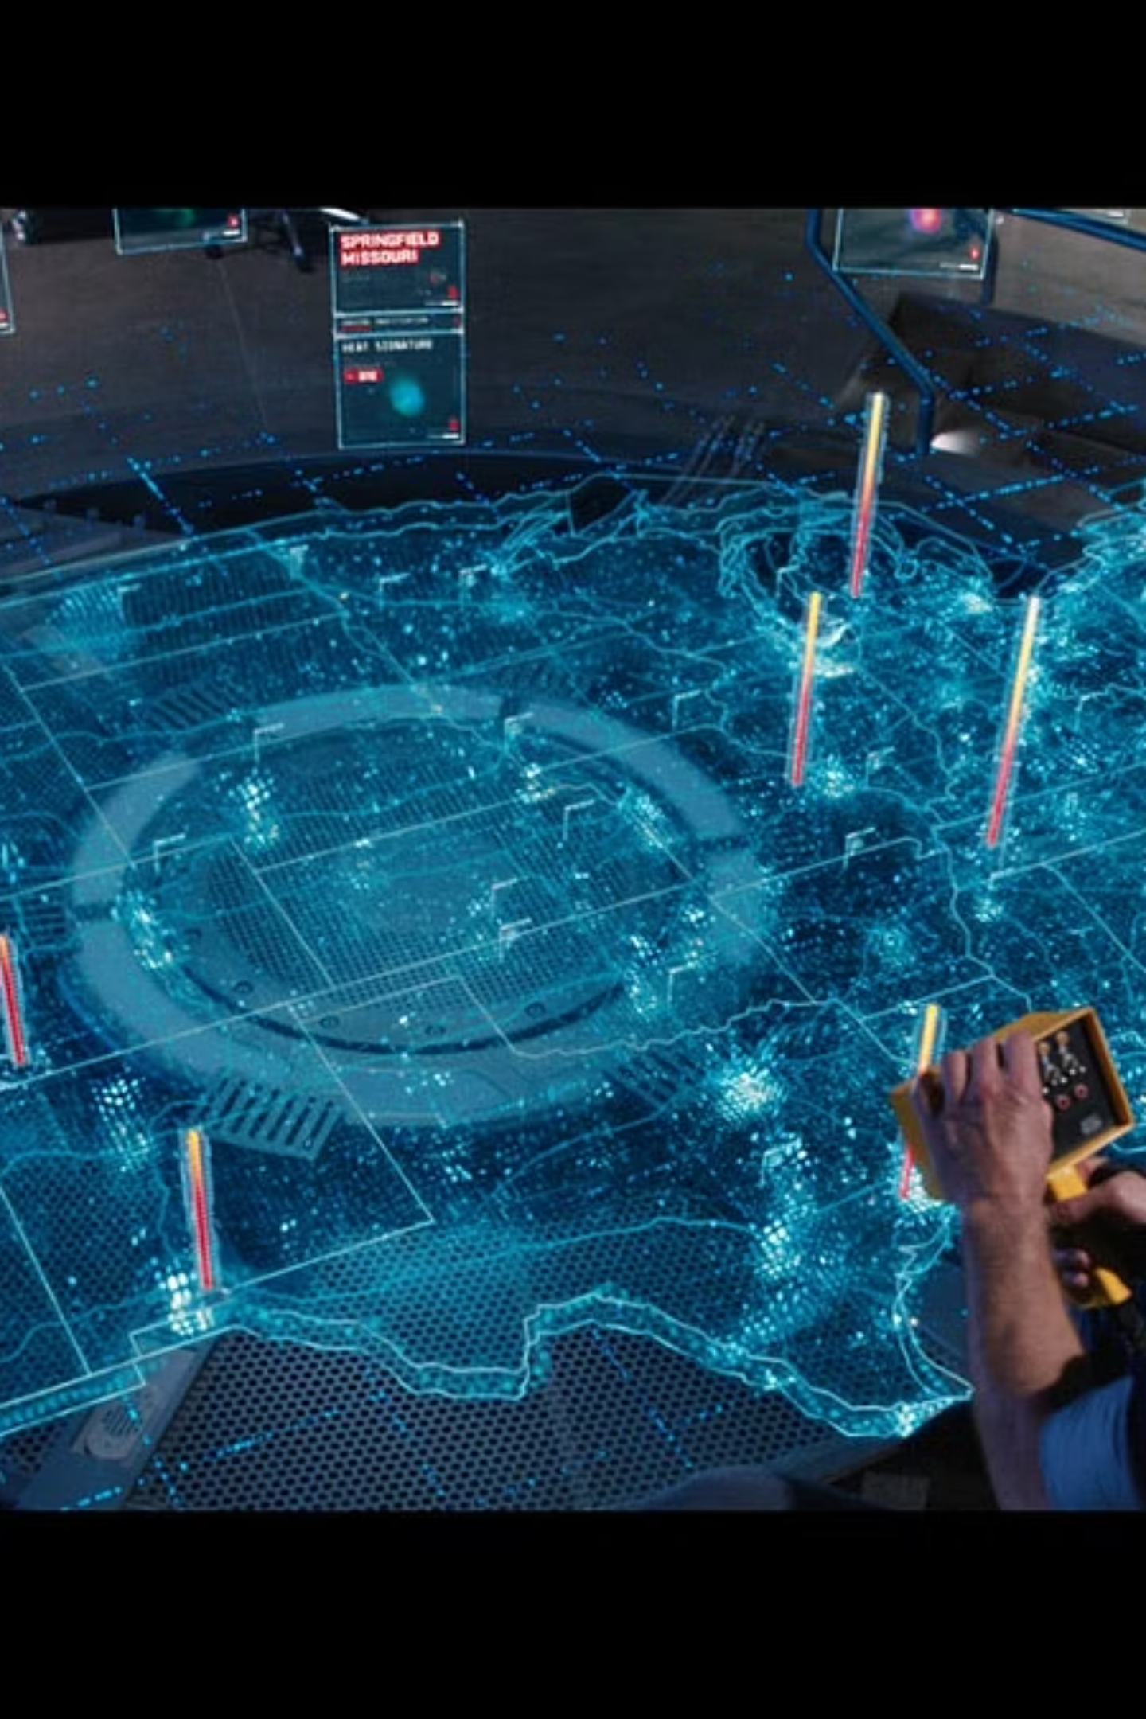
Duality AI: Bridging the Virtual and Physical Worlds with Digital Twin Simulation

Slide 2
The Challenge: Bringing AI Safely into the Real World
Unpredictable Environments
Brittle Systems
Ensuring Reliability
Traditional coding leads to AI that is costly, slow to deploy, and breaks easily under new circumstances.
How do we make AI models safe, adaptable, and consistently reliable in physical settings?
Autonomous robots and self-driving vehicles struggle with dynamic, ever-changing real-world conditions.

Slide 3
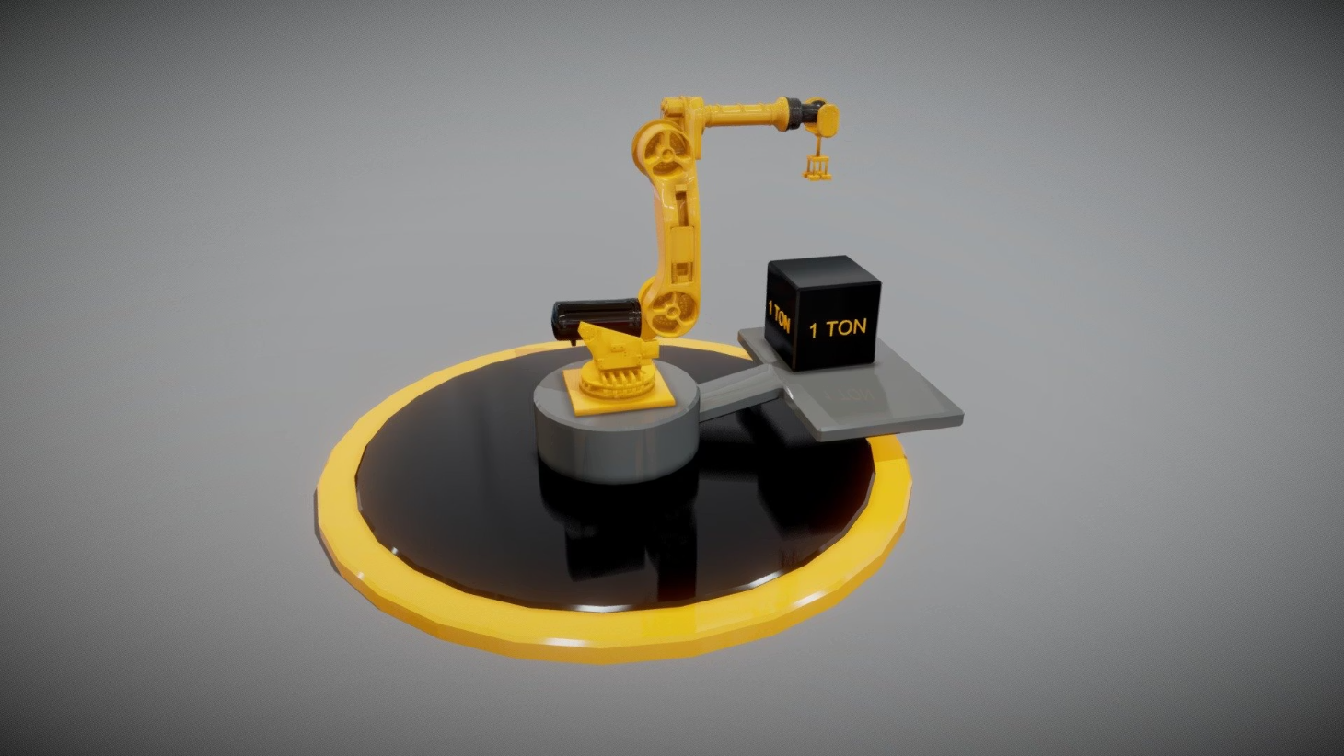
Duality AI’s Solution: High-Fidelity Digital Twin Simulation
The Falcon platform creates realistic, reusable digital twins for testing AI in virtual replicas of real environments. This enables:
Accelerated, cost-effective training and fine-tuning of embodied AI models.
Thorough validation before real-world deployment.
Avoidance of AI hallucinations and unpredictable behaviors.

Slide 4



Key Technology: Task Coding Framework & Embodied AI
LLM Integration
Adaptable Behaviors
Reduced Reprogramming
Utilizes Large Language Models (LLMs) to translate high-level goals into executable robotic tasks.
Supports generalized, prompt-driven AI behavior adaptable to new missions and environments.
Reduces reprogramming costs and time from months to minutes, significantly boosting efficiency.

Slide 5
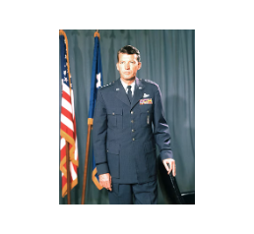
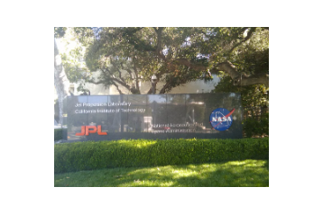
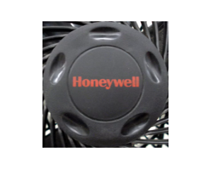
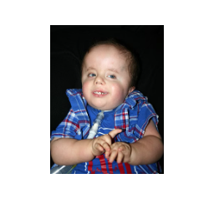
Real-World Impact: Partnerships & Use Cases
Duality AI collaborates with leaders like DARPA, NASA-JPL, and Honeywell, advancing autonomous robotics development. Integration with AWS SimSpace Weaver enables city-scale simulations, while the FalconCloud platform democratizes access to powerful simulation tools across industries.

Slide 6
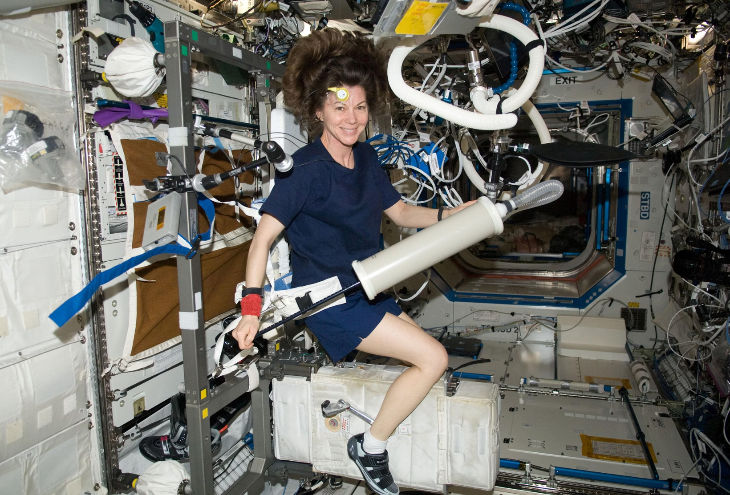
Demonstration: Space Station AI Training Challenge
Synthetic datasets generated by Falcon are used to train object detection models in complex space station environments.
Participants optimize AI for critical safety equipment detection.
Models are tested under varied conditions to ensure robustness.
This showcases Falcon’s unique ability to generate high-quality synthetic data for rigorous AI training.

Slide 7



Industry Recognition & Thought Leadership
Real Time Conference 2023
I/ITSEC & GVSETS
AWS Partner Network
CEO Apurva Shah's keynote highlighted digital twin simulation for bridging AI to reality.
Presentations at key industry events showcased Duality AI's innovative contributions.
Active membership in the APN expands simulation accessibility and reach.

Slide 8



Why Digital Twin Simulation is the Future of Autonomous Systems
Digital twin simulation is revolutionizing the development and deployment of autonomous systems by:
Reducing Sim2Real Gap
Dramatically narrows the gap hindering AI deployment in physical systems.
Ensuring Safety & Scalability
Enables safe, predictable, and scalable AI integration into robotics and smart infrastructure.
Accelerating Innovation
Speeds up innovation cycles while effectively controlling costs and mitigating risks.

Slide 9
The Vision: A World Where AI and Robots Collaborate Seamlessly
"We envision a future where AI models learn and adapt like humans, guided by simulation-tested reliability, and autonomous systems respond naturally to unforeseen scenarios."
This transformation spans industries from defense and space to smart cities and industrial automation, creating a new era of intelligent, adaptable machines.

Slide 10

Join Duality AI in Shaping the Future of Embodied Intelligence
Explore Falcon and FalconCloud duality.ai
Partner with us to unlock the full potential of AI safely in the physical world.
Together, let’s build smarter, safer, and more adaptable autonomous systems.

